Slide 1


PADMAVANI ARTS & SCIENCE COLLEGE FOR WOMEN (AUTONOMOUS)
(Affiliated to Periyar University, Salem)
Accredited by NAAC with A+ Grade (CGPA 3.44) & Cycle 2
Department of computer science & computer application
Bachelor of computer application
A.G.SHALINI (Reg.no 24PVUCA021)
A.PAVITHRA(REG.NO 24PVUCA015)

Slide 2
VIRTUAL CLASSROOM SYSTEM

Slide 3
ABSTRACT
The population of students all over the world is growing without a proportionate increase in teaching/learning resources/infrastructure. There is also much quest for learning in an environment that provides equal opportunities to all learners.
Based on our findings, a mathematical model Web-based Virtual Classroom system (WebVCS) was developed to provide a viable medium through which education can be offered in tertiary institutions that can carter for varieties of learners irrespective of their abilities, dispositions.
The key objects used in creating the WebVCS model are: Courses, Students, Instructors, Discussion, Quiz and Learning material.

Slide 4
EXISTING SYSTEM
The prospect of carrying a whole university experience compacted into a particular device is rare to say the lowest volume.
Traditionally, a degree of passivity is anticipated throughout lectures, extensively formerly note-taking and listening, whereas discussion with preceptors is distributed at a defined time.
On- line knowledge demands springing into action, acceptive course material throughout a form of transmission formats, and taking part in online exchanges which could continue indefinitely.

Slide 5
PROPOSED SYSTEM
In Proposed to automate the task of teachers and students for the given work and also eliminate the manual paperwork.
To create a system that implements features such as Courses, Students, Instructors, Discussion, Quiz and Learning material to enhance the virtual classroom experience.
User authentication and authorization are implemented to ensure the security of the system, while classroom creation and management provide teachers with the flexibility to create and manage virtual classrooms as needed.

Slide 6
SYSTEM REQUIREMENTS
SOFTWARE REQUIREMENTS:
Operating System : Windows-10/11 (64-bit).
Frontend : HTML 5 and Bootstrap 4.5
Backend : Python 3.10 (64-bit)
Web Framework : Django 4.5
Database : SQLite 3.0
IDE Tools : Visual Studio Code 1.8 (64-bit)
HARDWARE REQUIREMENTS:
System : Pentium IV 2.4 GHz.
Hard Disk : 500 GB.
Monitor : 15 VGA Colour.
Mouse : Logitech.
RAM : 4 GB.

Slide 7
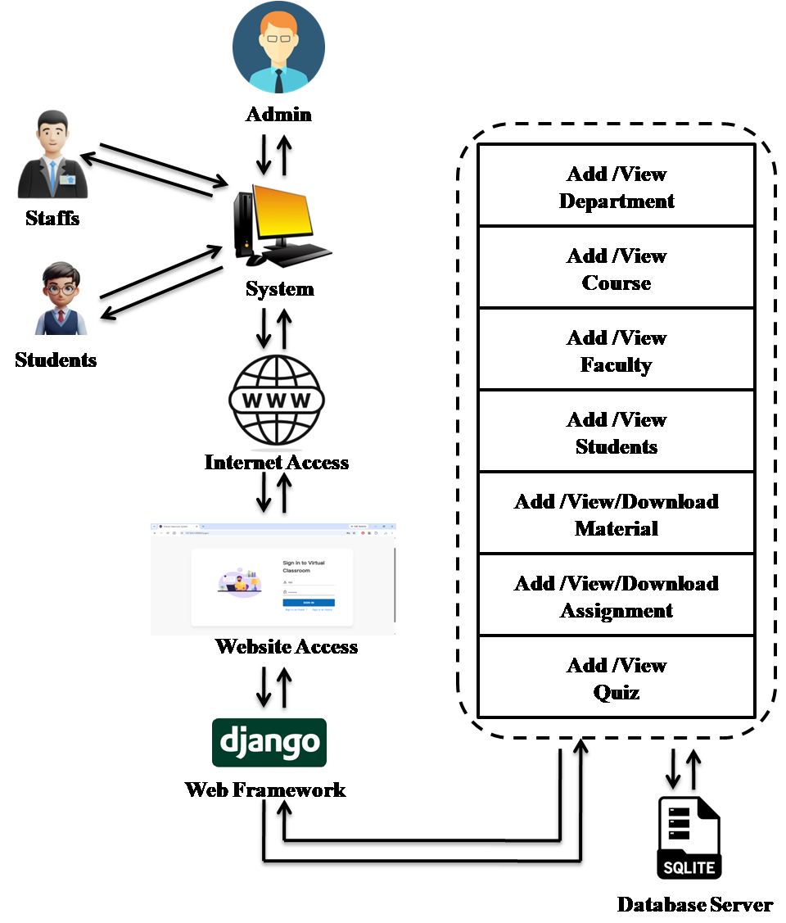
SYSTEM ARCHITECTURE

Slide 8
LIST OF MODELES
Staff Module
Student Module
Login Module
Upload/Download Videos
Upload/Download Notes
Upload/Download Assignment
View Assignment Status

Slide 9
STAFF MODULE
The staff module in this application can first register their details like name, email, contact details, ID, department and password then only the user can login to the application.
STUDENT MODULE
The student module in this application can first register their details like name, email, contact details, ID and password then only the user can login to the application.
LOGIN MODULE
The Login module in this application can select the user type, username and password then only the user can
login to the application

Slide 10
UPLOAD/DOWNLOAD VIDEOS
UPLOAD/DOWNLOAD NOTES
*The video upload/download module in this application can staff upload the videos like code, subject name, video name and date. Student can view the video and download the videos.
*Staff uploads the videos like subject wise
*Big data
*Internet of Things
*Python
*Mobile Security
*The Notes upload/download module in this application can staff upload the notes like code, subject name, pdf and date. Student can view the notes and download the notes. *Staff can upload the Notes like subject wise
*Big data
*Internet of Things
*Python
*Mobile Security

Slide 11
UPLOAD/DOWNLOAD ASSIGNMENT
VIEW ASSIGNMENT STATUS
*The Assignment upload/download module in this application can staff uploads the Assignment like code, Subject name, Topic and date. Student can view the Assignment and download the Assignment.
*Staff can upload the Assignment like subject wise
*Big data
*Internet of Things
*Python
*Mobile Security
*The View Assignment status module in this application can staff view the Assignment like code, subject name, Topic and date. Student can upload the Assignment and Staff can check the Assignment status that are submitted by the students in the website.
*Staff can view Assignment status like subject wise
*Big data
*Internet of Things
*Python
*Mobile Security

Slide 12
Sample output

Slide 13
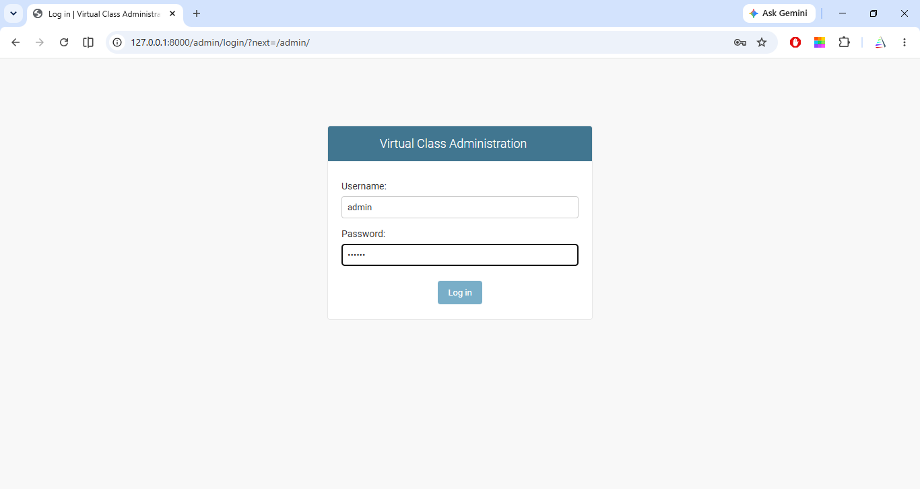
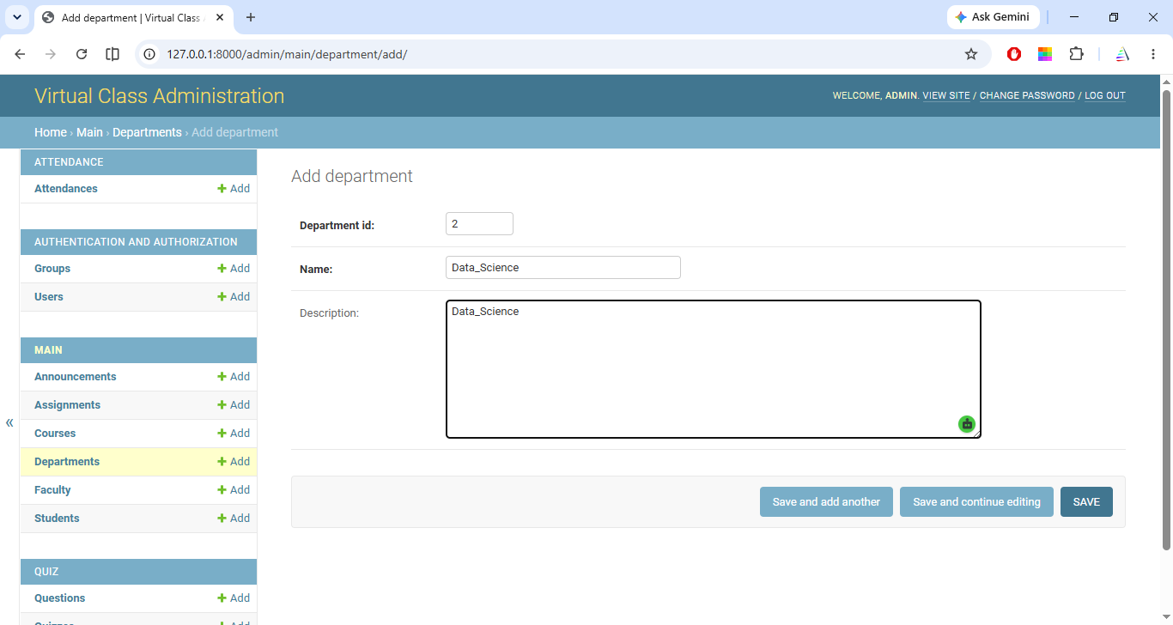
Admin Login
Add Department

Slide 14
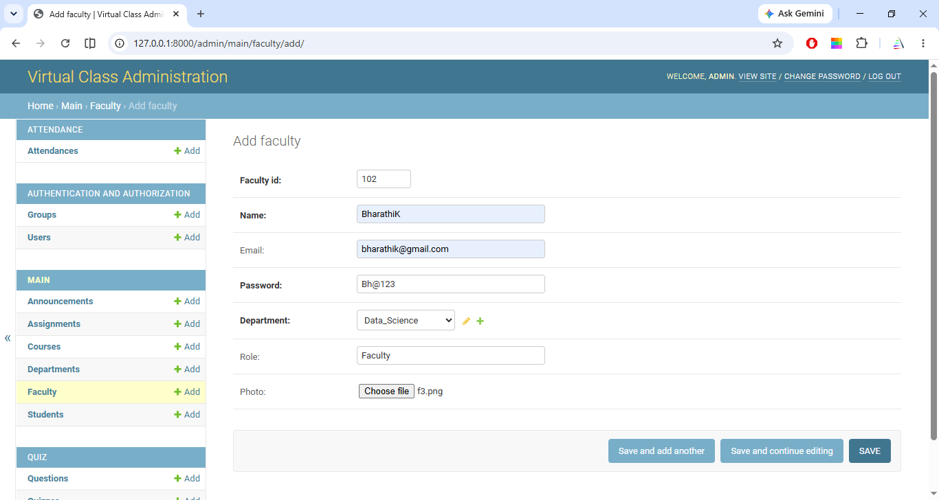
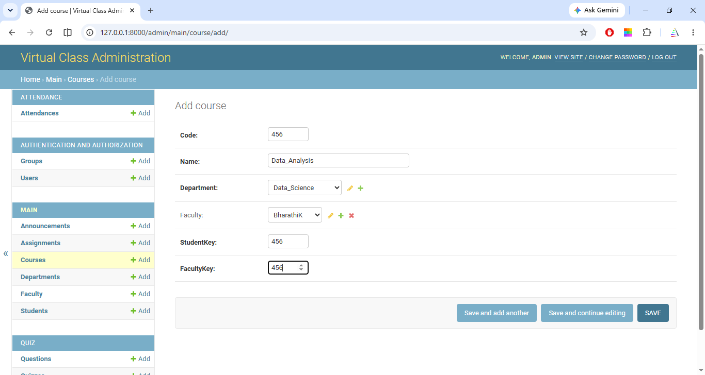
Add Faculty
Add Course

Slide 15
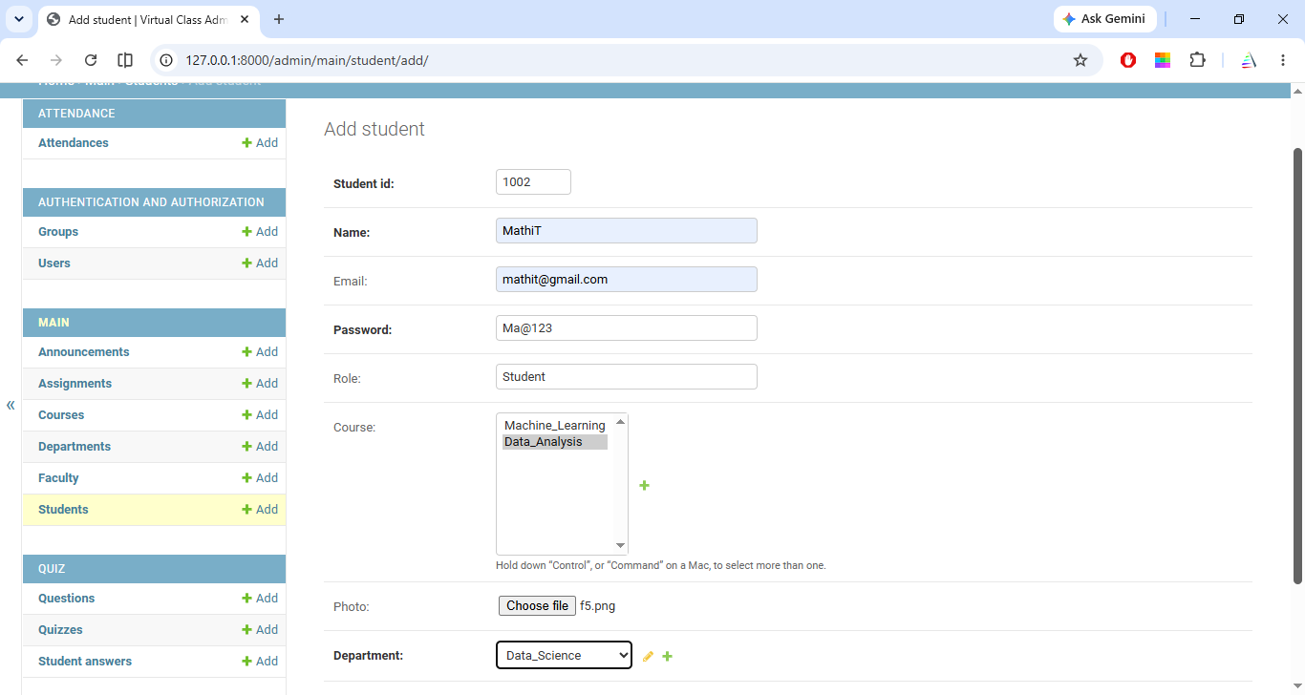
Add Students

Slide 16
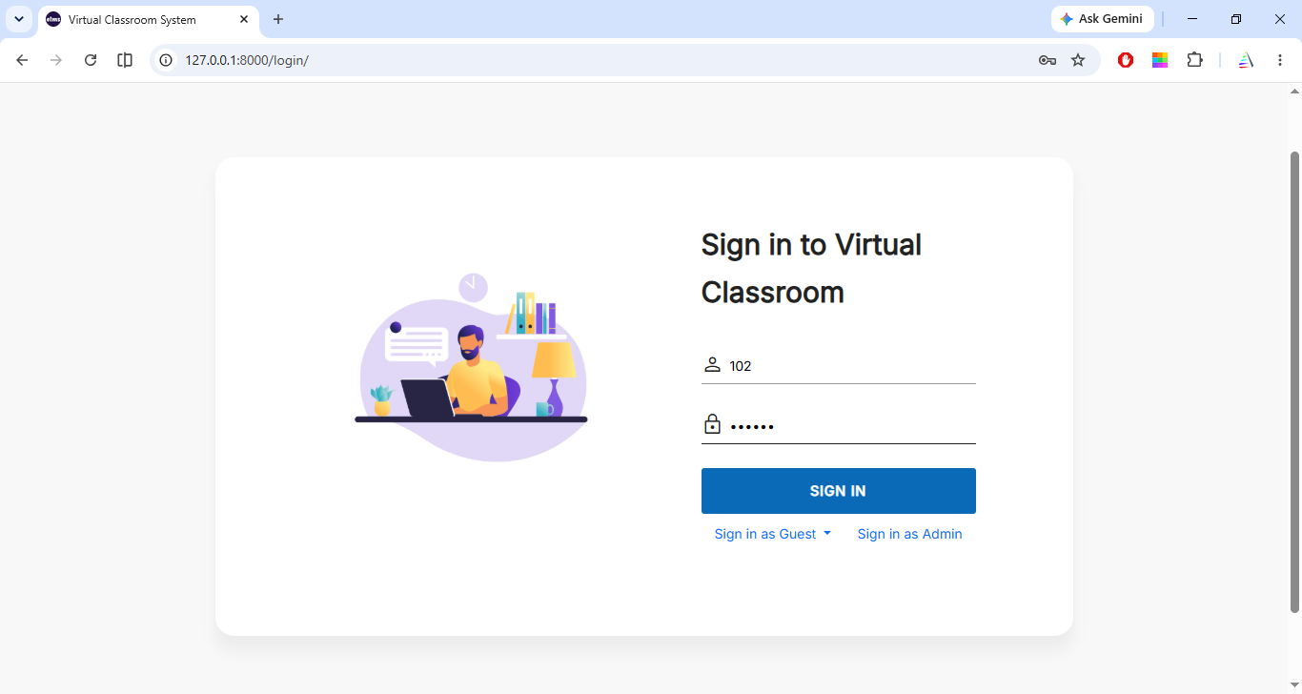
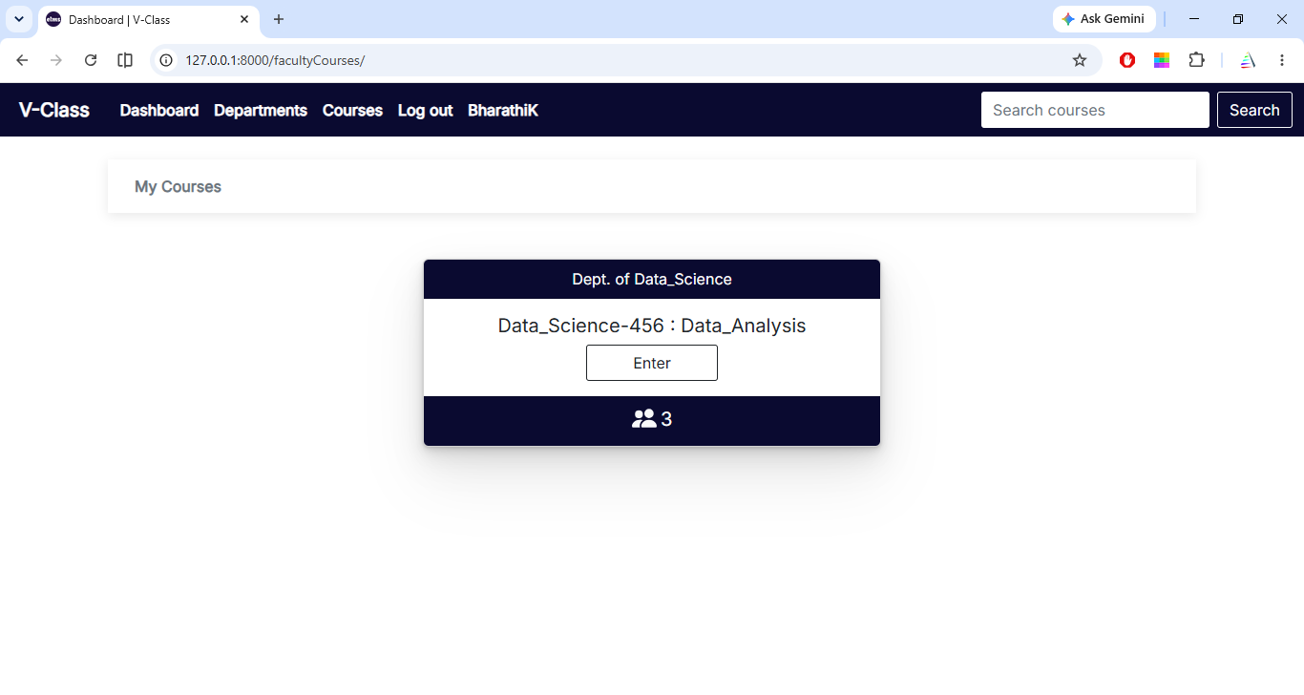
Faculty Login
Faculty Dashboard

Slide 17
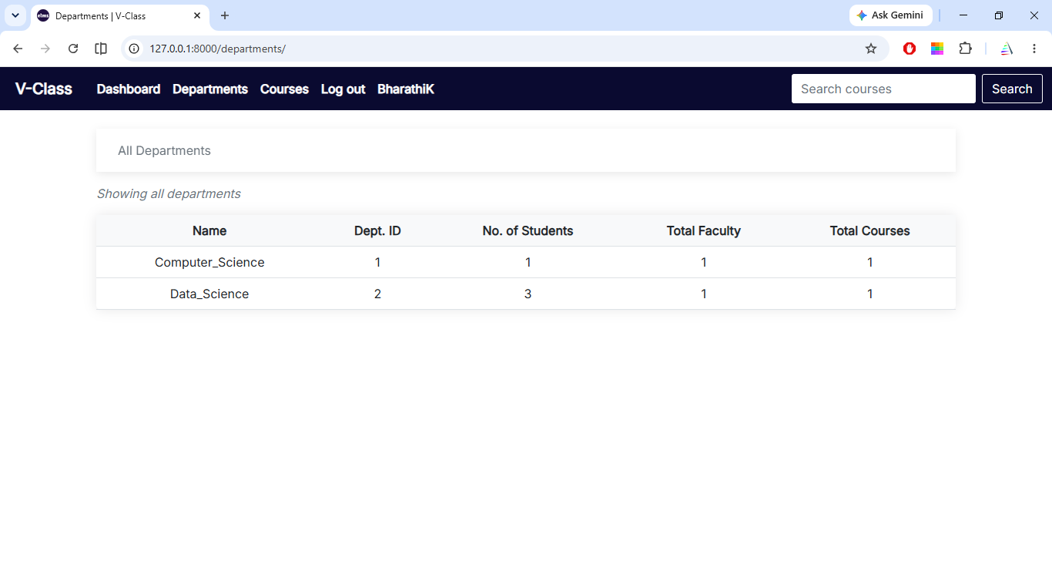
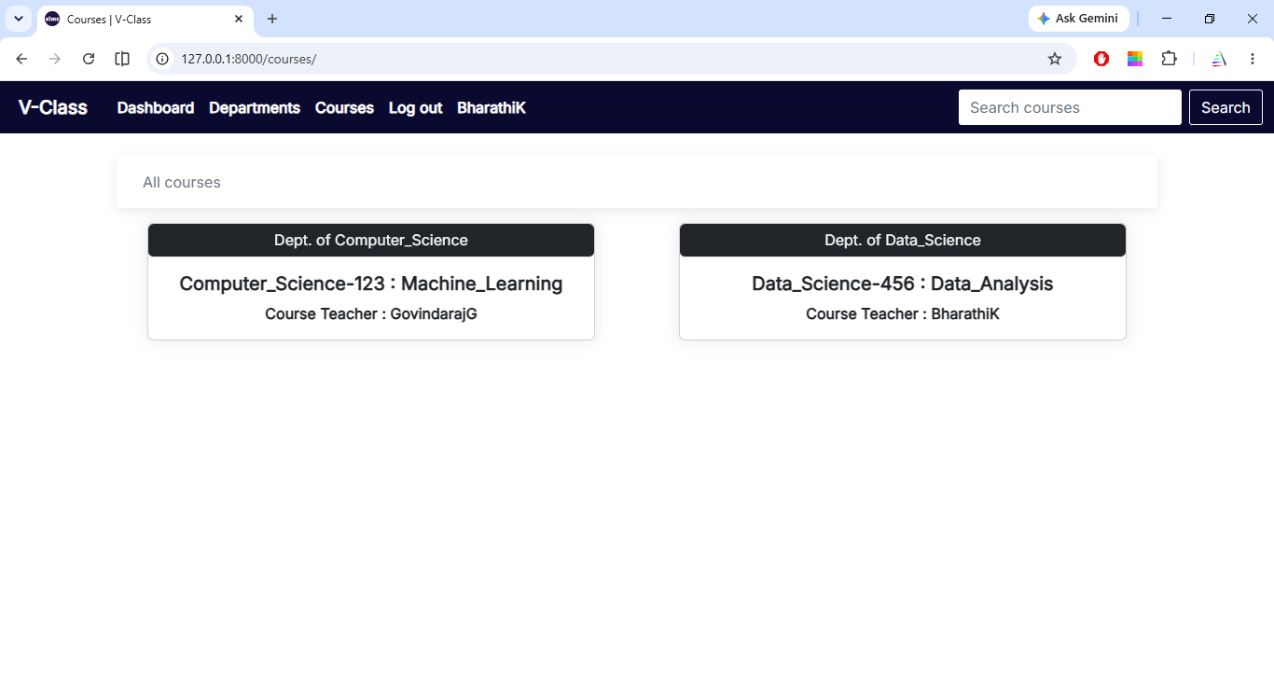
View All Department
View All Courses

Slide 18
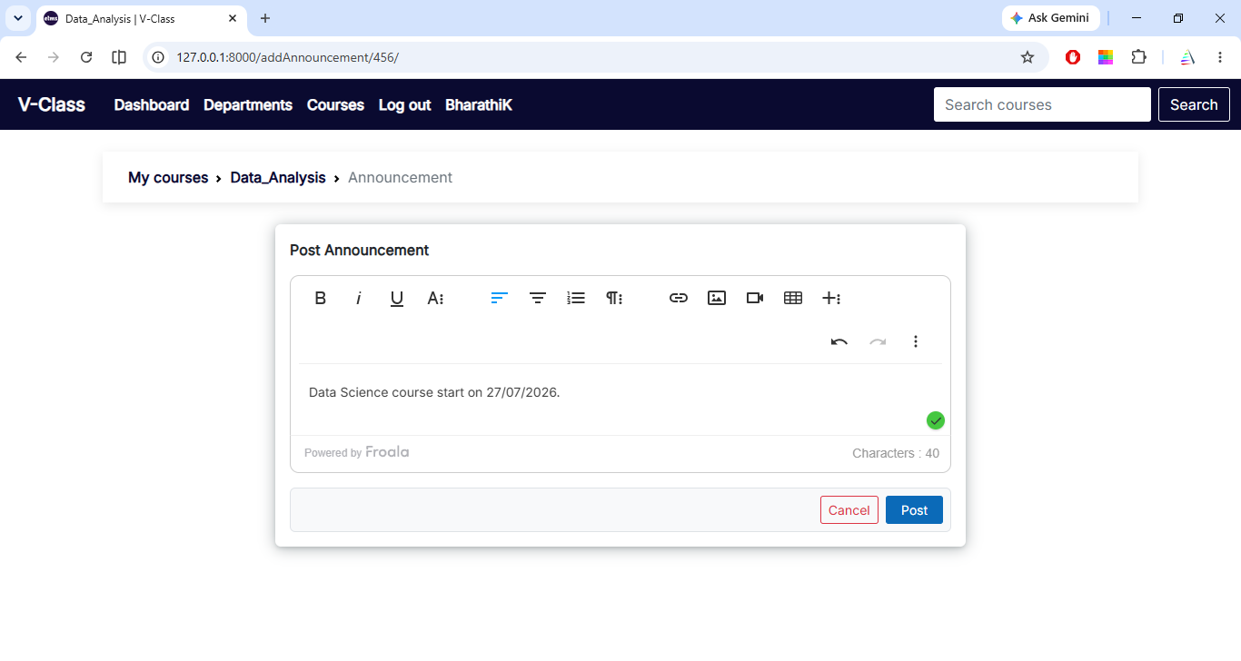
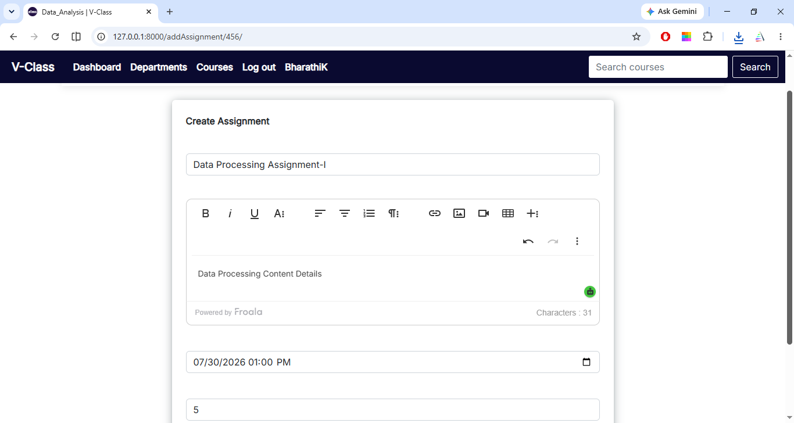
Add Announcement
Create Assignment Details

Slide 19
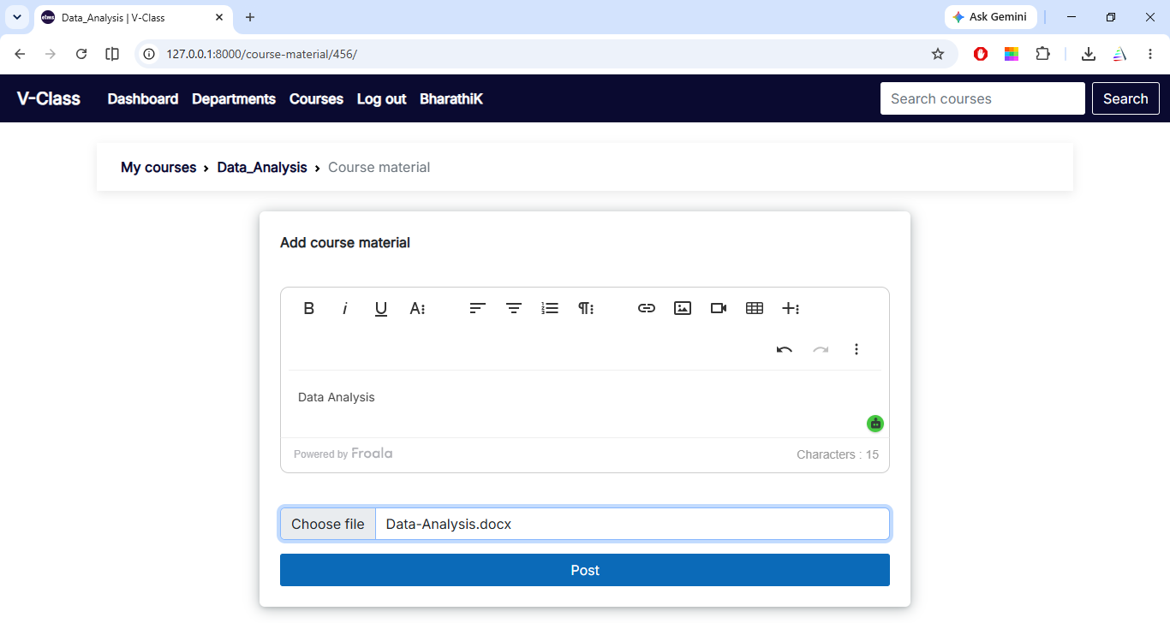
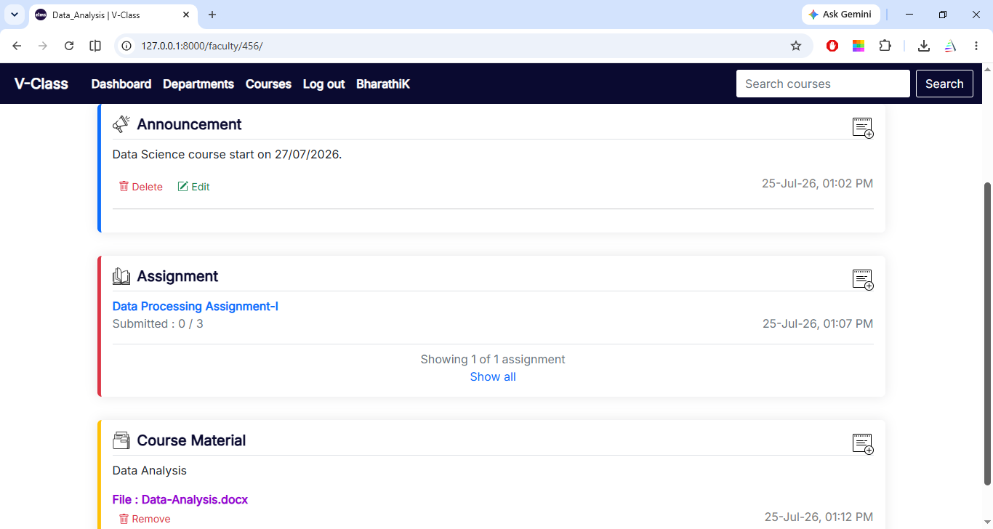
Add Course Material
Faculty Dashboard

Slide 20
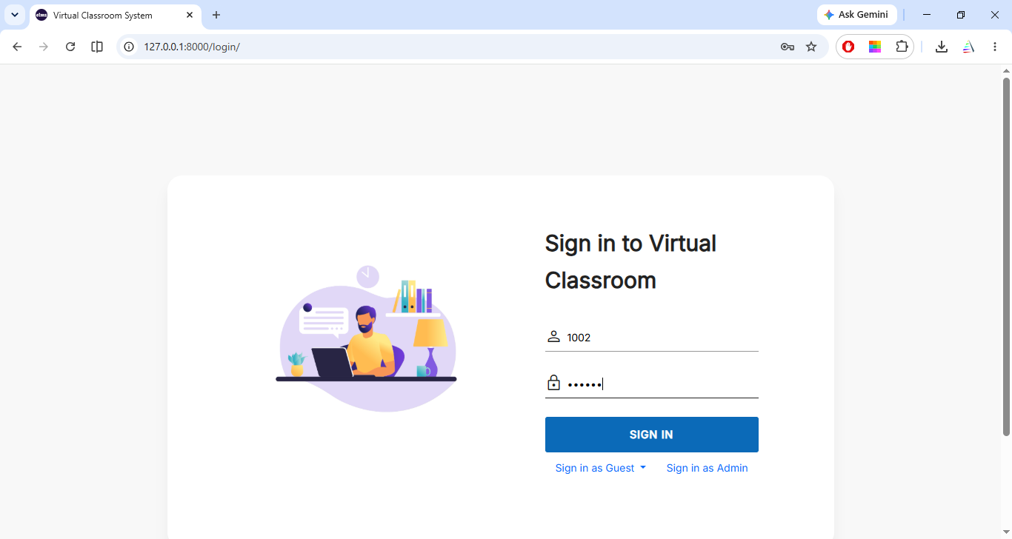
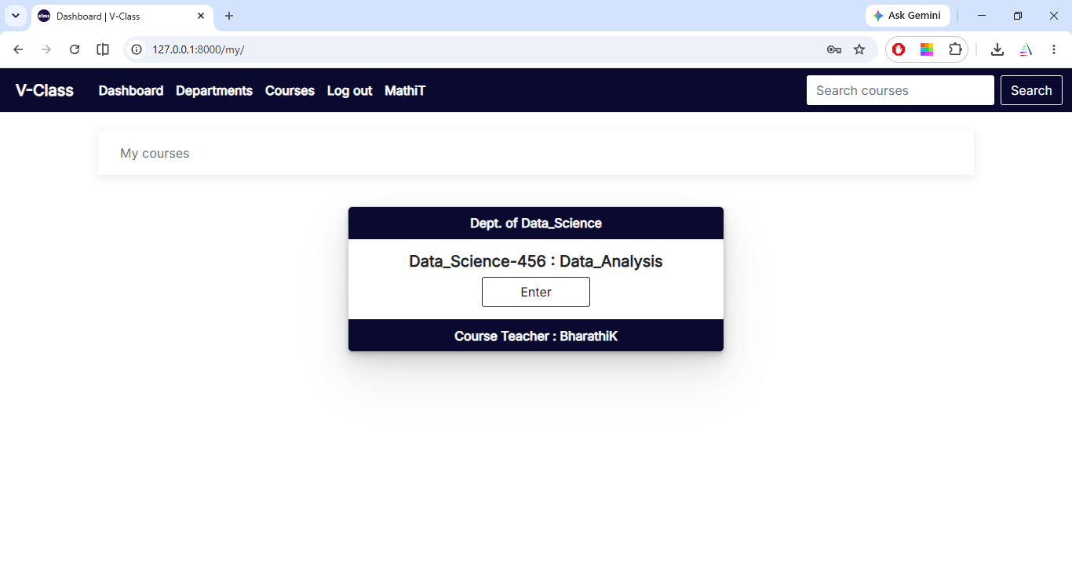
Students Login
Students Dashboard

Slide 21
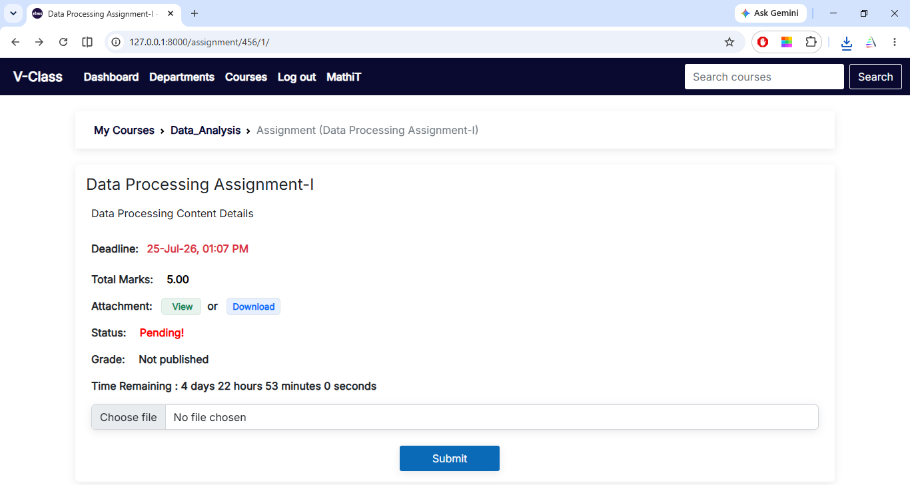
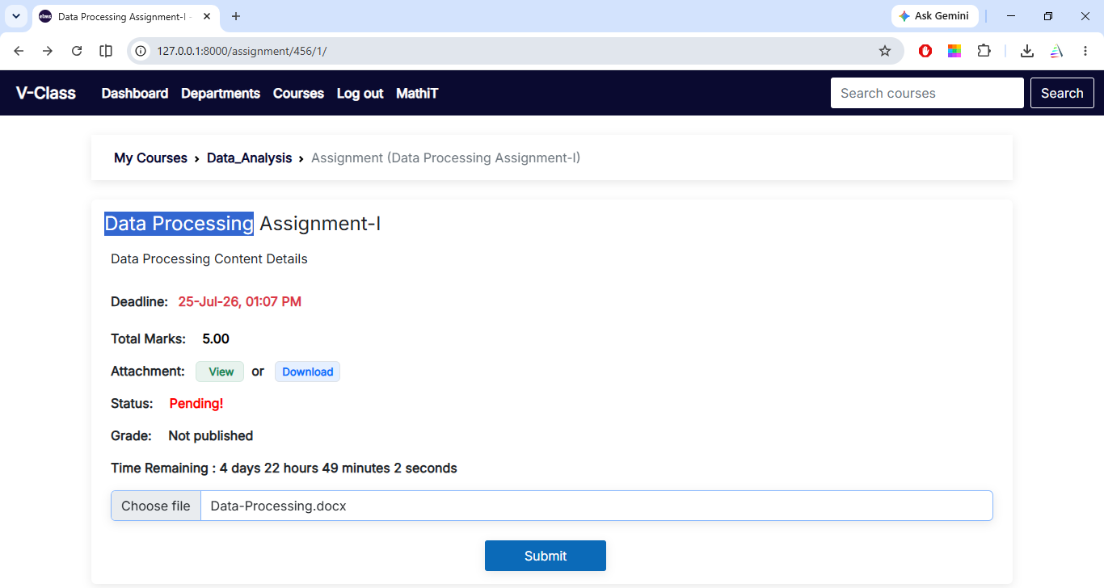
Students View Assignment Details
Students Submit Assignment

Slide 22
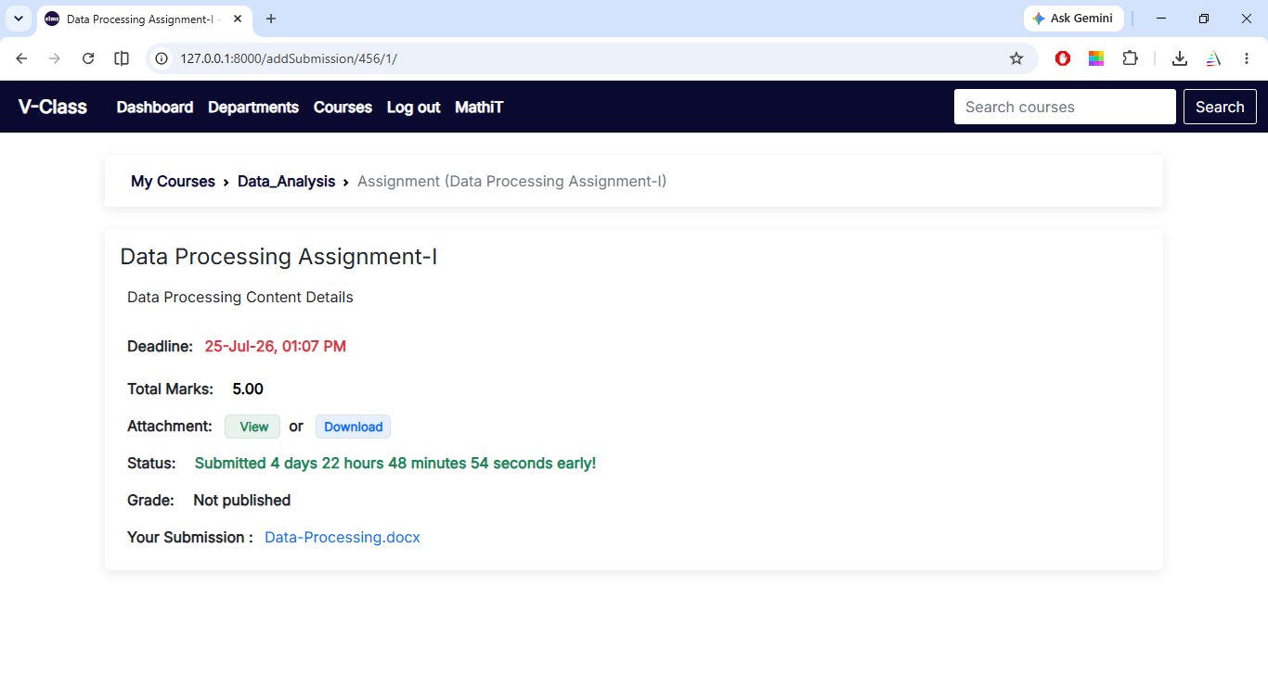
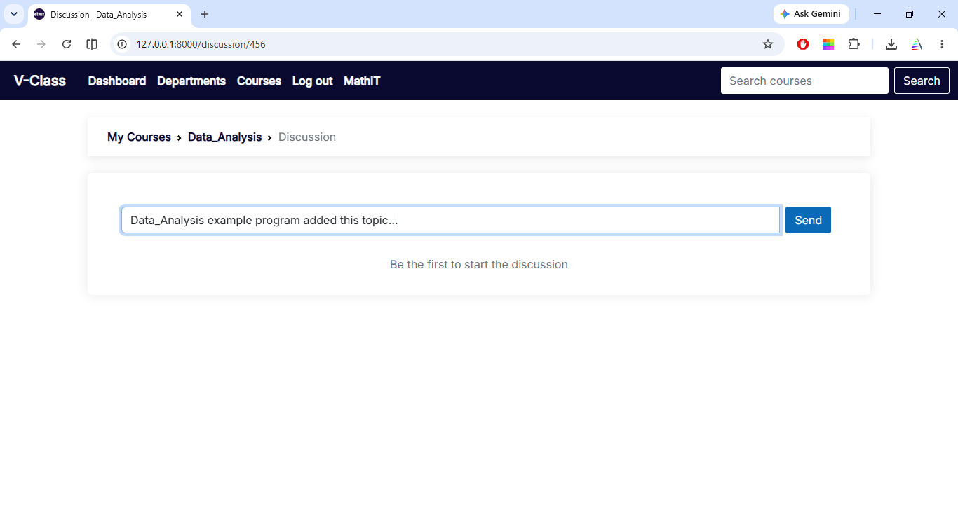
After view assignment status
Students Discussion

Slide 23
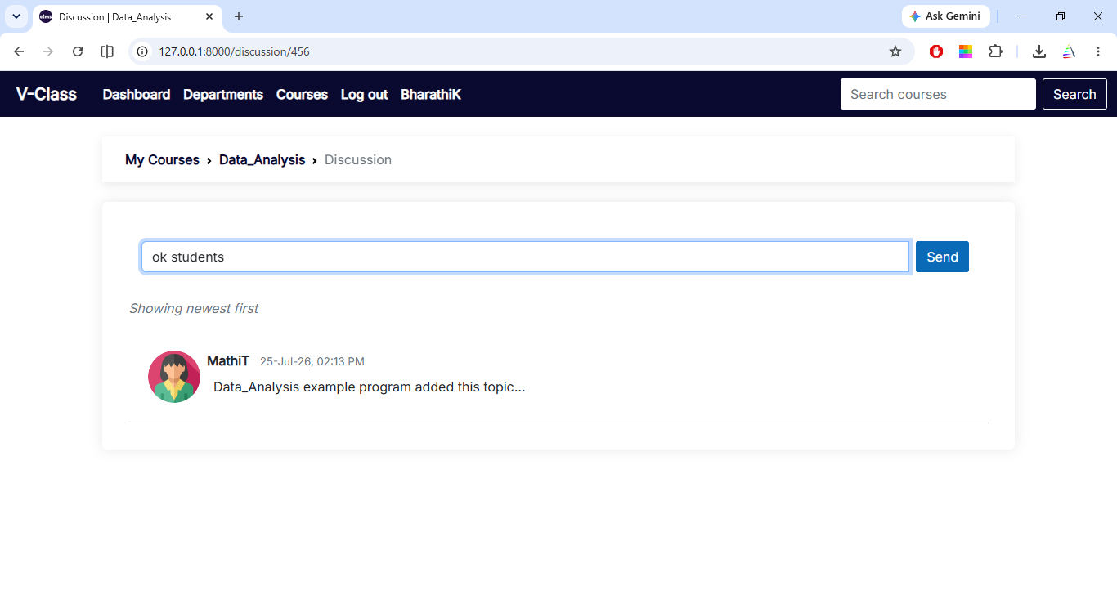
Faculty Reply Discussion Content

Slide 24
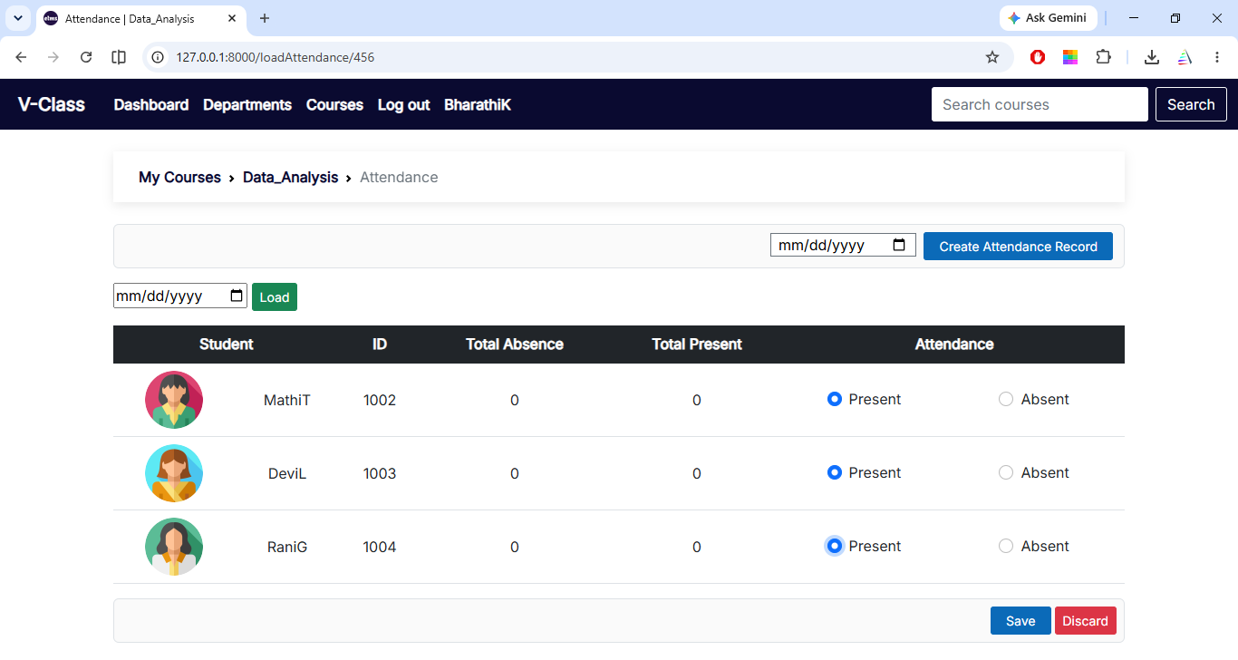
Faculty Take Attendance on Course Based

Slide 25
CONCLUSION
*The research developed a Web-based Virtual Classroom System (WebVCS) as an alternative to traditional teaching and learning.
*It can improve access to quality education.
*Government agencies should collaborate to implement and commercialize the WebVCS model.
*Internet and computers should be made available, especially in remote areas.
FUTURE WORK
E-learning is the future and will become more accessible as computer ownership increases.
Faster internet enables better multimedia and online learning experiences.
Online and hybrid learning are becoming increasingly popular among students.

Slide 26
THANK YOU

